Slide 1
AstroEngr 331X
Eclipse & Impact on a Satellite’s Electrical Subsystem
May 2024

Slide 2
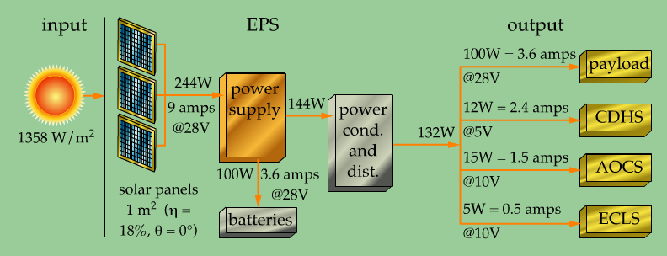
The Electrical Power Subsystem

Slide 3
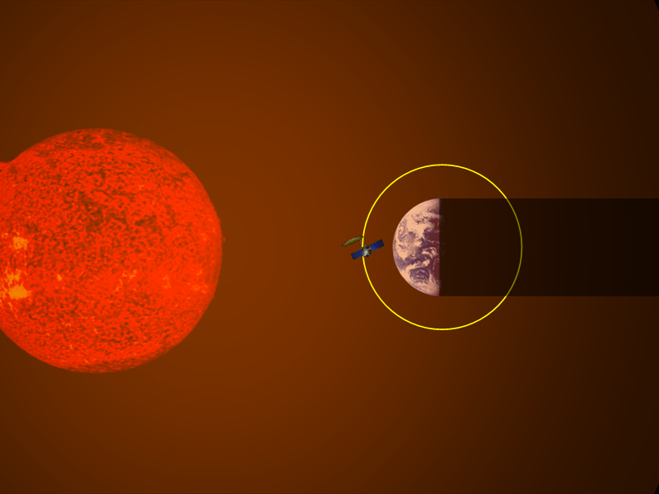
Eclipse Region
Sun in view: solar arrays can generate Power
Eclipse Region: solar arrays cannot generate Power

Slide 4






Eclipse Geometry (Circular Orbit)
$$R_{⊕}$$
$$ρ$$
Earth’s Angular Radius
Time in Eclipse (TE) and in Sun (TS)
$$ρ=\sin^{−1}\left(\frac{R_{⊕}}{R_{⊕}+h}\right)$$
$$TE=\frac{2ρ}{{360}^{o}}$$
$$TS=P−TE$$
h: circular orbit altitude
Orbital Period $P=2π\sqrt{\frac{a^{3}}{μ}}$

Slide 5
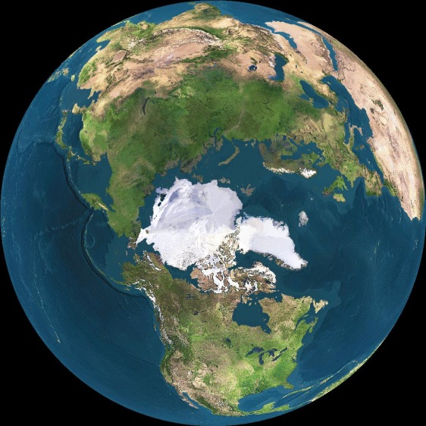
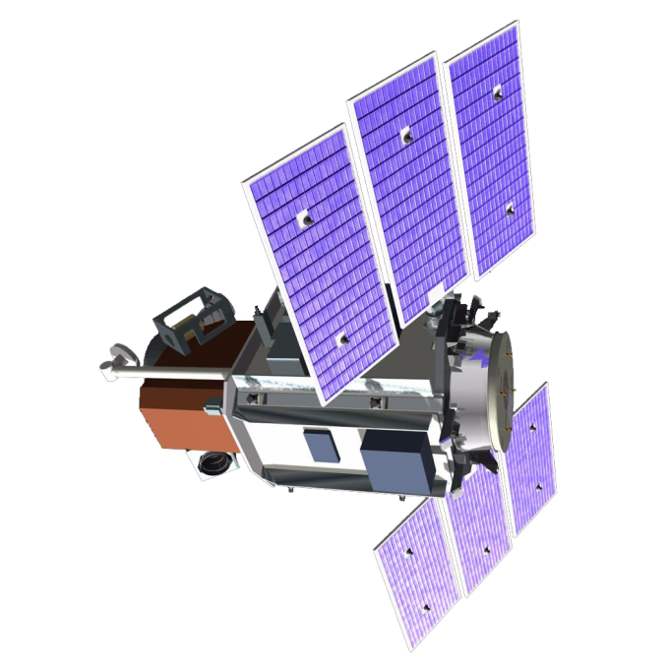
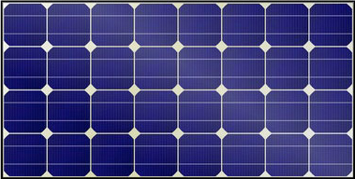
subsystems + payload
battery

Slide 6
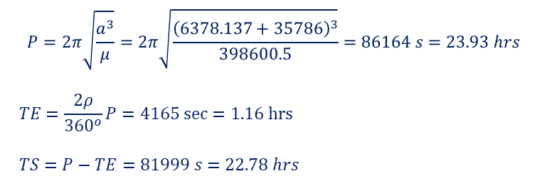




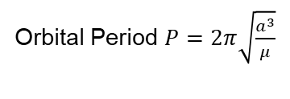
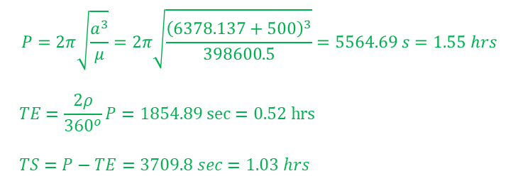
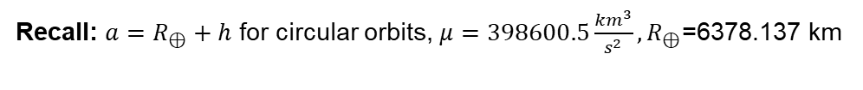
Eclipse Calculations
Earth’s Angular Radius
Time in Eclipse (TE) and in Sun (TS)
$$ρ=\sin^{−1}\left(\frac{R_{⊕}}{R_{⊕}+h}\right)$$
$$TE=\frac{2ρ}{{360}^{o}}P$$
$$TS=P−TE$$
h: circular orbit altitude
Orbital Period $P=2π\sqrt{\frac{a^{3}}{μ}}$
Recall: $a=R_{⊕}+h$ for circular orbits, $μ=398600.5\frac{km^{3}}{s^{2}},R_{⊕}\text{=6378.137 }\text{km}$
Group 1
Group A
Calculate time in sun and time in eclipse for a satellite in Geosynchronous Orbit
h=35786 km
Calculate time in sun and time in eclipse for a satellite in Low-Earth Orbit
h=500 km,
$$ρ=\sin^{−1}\left(\frac{R_{⊕}}{R_{⊕}+h}\right)=\sin^{−1}\left(\frac{6378.137}{6378.137+35786}\right)={8.7}^{o}$$
$$ρ=\sin^{−1}\left(\frac{R_{⊕}}{R_{⊕}+h}\right)=\sin^{−1}\left(\frac{6378.137}{6378.137+35786}\right)={60.0}^{o}$$
$$P=2π\sqrt{\frac{a^{3}}{μ}}=2π\sqrt{\frac{{\left(6378.137+35786\right)}^{3}}{398600.5}}=86164 s=23.93 hrs$$
$$TE=\frac{2ρ}{{360}^{o}}P=4165 sec=1.16 hrs$$
$$TS=P−TE=81999 s=22.78 hrs$$
$$P=2π\sqrt{\frac{a^{3}}{μ}}=2π\sqrt{\frac{{\left(6378.137+500\right)}^{3}}{398600.5}}=5564.69 s=1.55 hrs$$
$$TE=\frac{2ρ}{{360}^{o}}P=1854.89 sec=0.52 hrs$$
$$TS=P−TE=3709.8 sec=1.03 hrs$$

